Slide 1
Applied Studies - Robotics and Game Making
Year 9 and/or 10

Slide 2
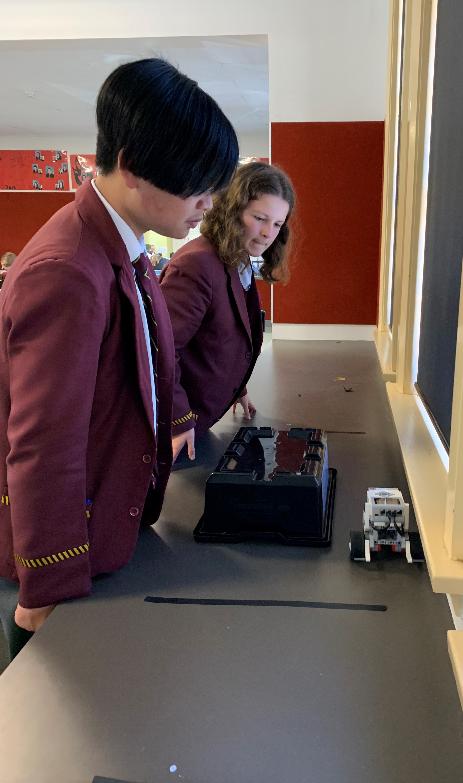
Robotics & Game Making
1 or 2 year course
Mix of theory and practical
One Semester of Robotics
One Semester of Game Making
Develops problem solving skills

Slide 3
Find out more…
Please feel free to contact Mrs Selina Kinne, Head of Technology and Applied Studies, at skinne@dominic.tas.edu.au

